Slide 1
Structured Analysis and Design Technique(SADT)
By
Chandler Pruitt

Slide 2
Description
Diagrammatic language used for creating designs for software
Consists of boxes and arrows
Two kinds of diagrams: activity model and data model
Available commercially as a CASE tool called IDEF0

Slide 3
History
Developed by Douglas T. Ross in 1974
Developed as a result of ongoing work in problem solving
Used in the MIT Automated Programming Tool Project(APT)
Used by US Airforce starting in 1973 as part of the Computer Aided Manufacturing Program

Slide 4
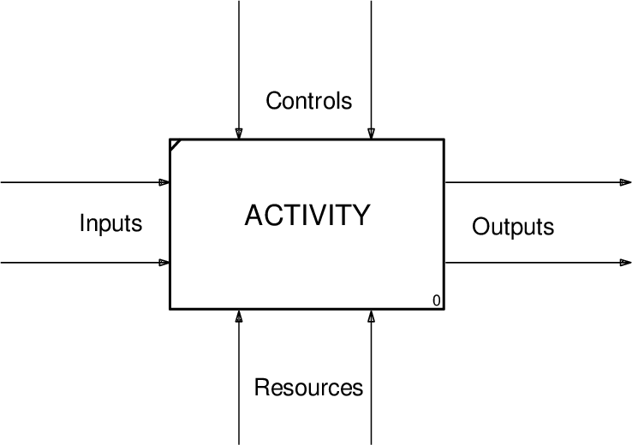
Activity Model
Shows the decomposition of an Activity
Input data is shown on left side of box
Control data is shown on top of box
Output data is shown on right side of box
Supporting Mechanism is shown on bottom of box

Slide 5
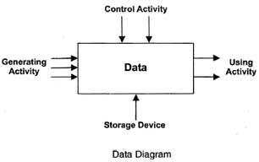
Data Model
Similar to Activity Model, but roles of activities and data are reverse
Left side of box is generating activity
Right side of box is using activity
Top of box is constraining activity
Bottom of box is storage mechanism

Slide 6
Pros and Cons
pros
cons
Provides precise method to represent complex systems
Allows non-specialists to understand requirements
Provides and easy way to measure progress
Not automated
Doesn't support a specific design methodology
Can be hard to understand when a lot of info is present

Slide 7
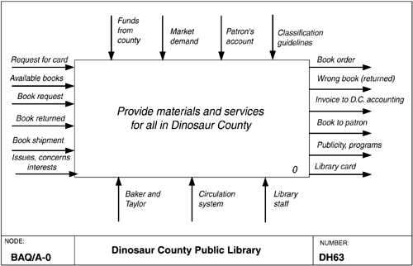
Example 1

Slide 8
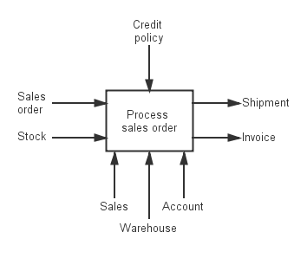
Example 2

Slide 9
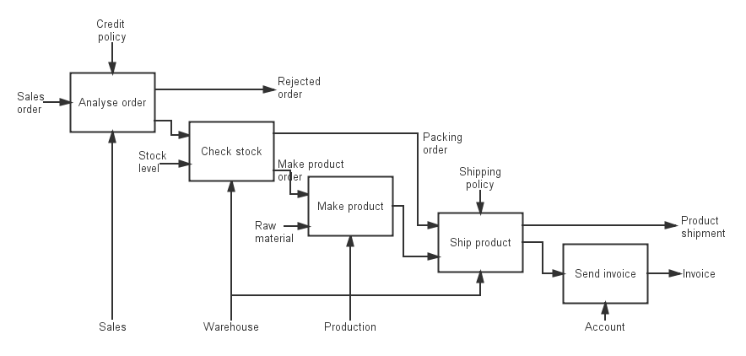
Example 3

Slide 10
Sources
http://r.web.umkc.edu/rer554/cs457_homework5.html
http://www.cs.toronto.edu/~jm/2507S/Notes04/SADT.pdf
http://flylib.com/books/en/1.172.1.51/1/
http://ecomputernotes.com/software-engineering/requirementsanalysis
https://www.researchgate.net/publication/303034352_Success_in_the_face_of_uncertainty_Human_resilience_and_the_accident_risk_bow-tie
http://blog.maxconsilium.com/2013/09/process-notation-p2.html

